Slide 1

Information Assurance
By: Nestor Rios

Slide 2
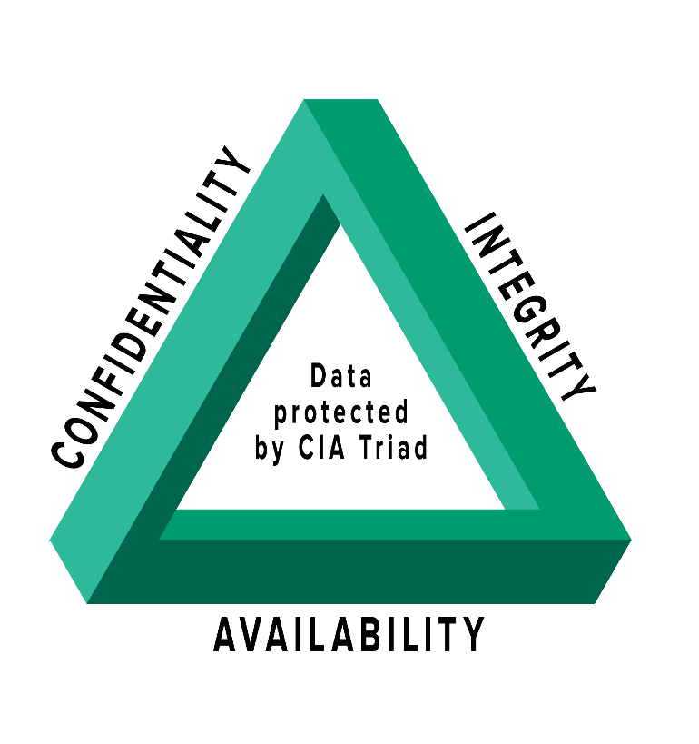
CIA Triad
Confidentiality – Protects sensitive information from unauthorized users.
Integrity – Data is accurate, trustworthy, and has not been altered with.
Availability – Data and resources are accessible to authorized users when needs.
Notes:
The CIA triad is a widely recognized and accepted model for information security. CIA stands for confidentiality, integrity, and availability, which are the three core tenets of information security. Confidentiality refers to protecting sensitive information from unauthorized access, disclosure, or theft. Integrity ensures that data is accurate, complete, and trustworthy, and has not been tampered with or altered. Availability ensures that data and resources are accessible to authorized users when needed. The CIA triad is important because it provides a framework for organizations to evaluate and implement security measures that protect their valuable assets and minimize the risk of security breaches. Security measures should be designed to address all three elements of the CIA triad to ensure the comprehensive protection of an organization's data and resources.

Slide 3
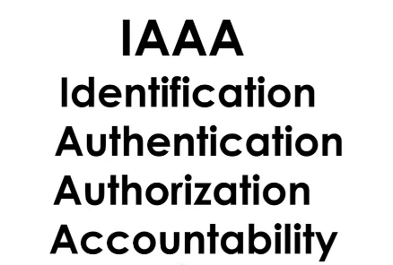
IAAA
Identification - Identifying a user, device, or entity attempting to access a system.
Authentication – The user is who they claim to be.
Authorization - What actions a user is allowed to perform on a system.
Accountability - Tracking and logging all actions taken on a system.
Notes:
IAAA, which stands for Identification, Authentication, Authorization, and Accountability, is a critical concept in information security that should be considered when creating security measures. Identification refers to the process of identifying a user, device, or entity attempting to access a system or resource. Authentication ensures that the user or entity is whom they claim to be through the use of credentials or biometric data. Authorization specifies what actions a user is allowed to perform on a system or resource based on their identity and authentication. Finally, accountability involves tracking and logging all actions taken on a system or resource to be audited and traced back to specific users or entities. Incorporating IAAA principles into security measures provides a robust and layered approach to protecting information assets and minimizing the risk of security breaches.

Slide 4
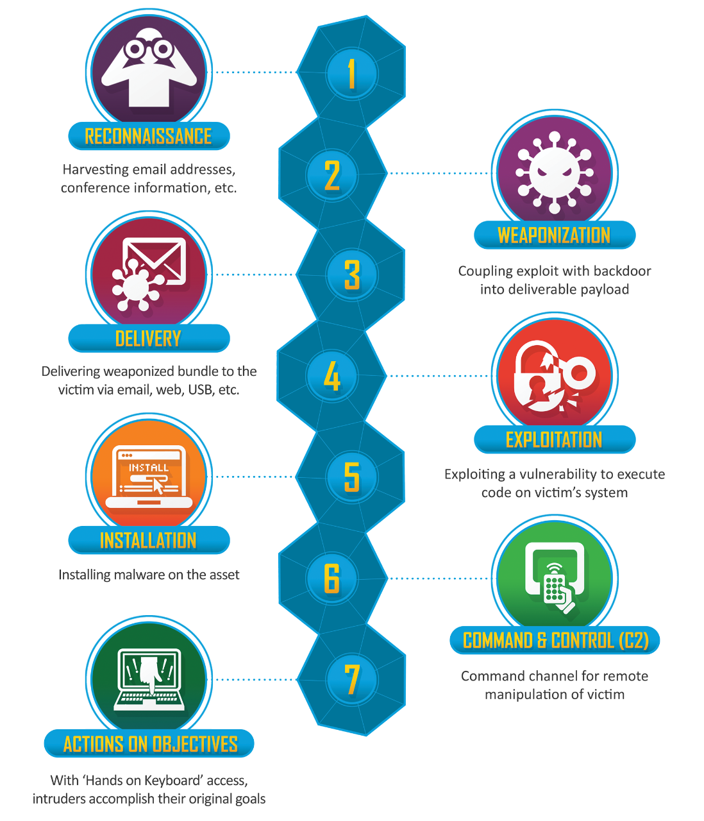
Cyber Kill Chain
The cyber kill chain is a framework that describes the stages of a cyber-attack.
There are ways to stop the cyber kill chain from happening.
Detect
Deny
Disrupt
Degrade
Deceive
Notes:
The cyber kill chain is a framework that describes the stages of a cyber-attack. There are 7 stages of the cyber kill chain: reconnaissance, weaponization, delivery, exploitation, installation, command and control, and actions on objectives. There are ways to stop the cyber kill chain from happening. The security control strategy you can use to stop the cyber kill chain is to detect, deny, disrupt, degrade, and deceive.
Detect - find out what’s going on and scan the network.
Deny - Stop the attack from happening.
Disrupt - Intercept and stop data communications carried out by the attacker.
Degrade - Develop methods to minimize an attack's efficacy.
Deceive - Deceive an attacker by supplying misleading information or deploying fake assets.

Slide 5
Stages of Cyber Kill Chain
Reconnaissance
What is it?
Research stage of operation
How is it used?
Attacker gathers information on the targeted system
Weaponization
What is it?
Creation of malware or malicious payloads
How is it used?
Exploit the identified vulnerabilities
Notes:
Reconnaissance
What is it:
Reconnaissance is the research stage of the operation by harvesting email addresses, conference information, etc.
How does it achieve:
The attacker gathers information about the target system, including identifying vulnerabilities and potential entry points.
Weaponization
What is it:
Weaponization is the creation of malware or malicious payloads to use against the targeted device.
How does it achieve:
The attacker creates malware, ransomware, worms, and much more that can exploit the identified vulnerabilities.

Slide 6
Stages of Cyber Kill Chain
Delivery
What is it?
Set of tools that are used to infiltrate a targeted network.
How is it used?
The attacker delivers the weapon to the target system.
Exploitation
What is it?
Vulnerability to executing code.
How is it used?
Weapon is activated on the target system.
Notes:
Delivery
What is it:
Delivery is a set of tools that are used to infiltrate a targeted network and reach users.
How does it achieve:
The attacker delivers the weapon to the target system like email, social engineering, and ransomware attack.
Exploitation
What is it:
Exploitation is a vulnerability to executing code on a victim’s system.
How does it achieve:
The weapon is activated on the target system. This allows the attacker to gain access and control of the system.

Slide 7
Stages of Cyber Kill Chain
Installation
What is it?
Installing any kind of malware onto the network
How is it used?
To maintain access to the targeted computer
Command and Control (C2)
What is it?
The command channel for remote manipulation
How is it used?
Connection to a remote server that the attackers can control
Notes:
Installation
What is it:
Installation is installing any kind of malware onto the targeted network to take control of the system.
How does it achieve:
The attacker installs additional tools and software on the targeted computer to maintain access.
Command and Control (C2)
What is it:
Command and control is the command channel for remote manipulation of the victim.
How does it achieve:
The attacker has established a connection to a remote server that they can control. This allows the attacker to issue commands to the compromised system, bypassing other security tools.

Slide 8
Stages of Cyber Kill Chain
Actions on Objectives
What is it?
Full access to the system
How is it used?
The attackers have full control of your system, and they can do whatever they want.
Notes:
Actions on Objectives
What is it:
Actions on objectives are full access (hands-on keyboard) to the system, so the attackers can accomplish their goals.
How does it achieve:
The attackers are now in and have full control of your system. The attacker has access to the compromised system, and they can do what they want like stealing data, disrupting operations, or just causing damage to the system.

